Slide 1


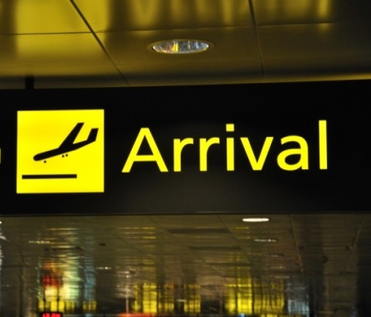

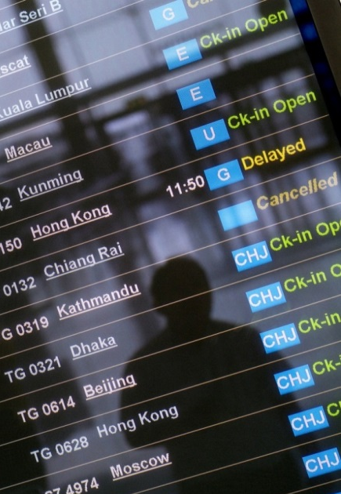

APPLY ADVANCED AIRFARE RULES AND PROCEDURES
D2.TTA.CL2.03
Notes:
Trainer to welcome students to the class.
Introduce self and state qualification to teach this unit
Give overview of qualifications and describe industry experience.

Slide 2

Subject Elements
This unit comprises eight elements:
Confirm client requirements for all purchases
Construct mixed class fares
Construct airfares incorporating add-ons
Prepare international pre-paid ticket advices
Construct round-the-world and round trip itineraries
Construct fares for open jaw journeys
Apply the pricing unit concept to fares
Maintain client file
Notes:
Trainer advises students this Unit comprises two elements, as listed on the slide explaining:
Each Element comprises a number of Performance Criteria which will be identified throughout the class and explained in detail
Students can obtain more detail from their Trainee Manual
The course presents advice and information but where their workplace requirements differ to what is presented, the workplace practices and standards must be observed.

Slide 3

Assessment
Assessment for this unit may include:
Oral questions
Written questions
Work projects
Workplace observation of practical skills
Practical exercises
Formal report from supervisor
Notes:
Trainer advises students that assessment for this Unit may take several forms all of which are aimed at verifying they have achieved competency for the Unit as required.
Trainer indicates to students the methods of assessment that will be applied to them for this Unit.

Slide 4

Element 1: Confirm client requirements for all purchases
Performance Criteria for this Element are:
1.1 Identify and confirm needs and preferences of client
1.2 Identify and access appropriate resources to enable processing of client requirements
Notes:
Trainer to relate performance criteria to element 1.
Performance criteria is the process by which the students training match the learning element
The element is the skill
To assess competency in the skill, the performance criteria is used to outline activities that can be used to assess competency.
The trainer should relate how the performance criteria is related to the element.
To be able to Confirm client requirements for all purposes the students must be able to:
Identify and confirm needs and preferences of client
Identify and access appropriate resources to enable processing of client requirements.

Slide 5

1.1, 5.1, 6.1 Identify and confirm needs and preferences of client
Needs and preferences of client may relate to:
Packages
Budget
Timing and duration
Number of travellers – including considerations applicable to groups, families and individuals
Destinations
Carrier
Quotations and advice supplied to client
Notes:
Trainer to advise:
PC: 1.1, 5.1 & 6.1
Needs and preferences of client may relate to:
Packages
Budget
Timing and duration
Number of travellers – including considerations applicable to groups, families and individuals
Destinations
Carrier
Quotations and advice supplied to client.
Brainstorm/Class discussion:
Are there any other needs or preferences you would include?
Ask trainees to work in pairs to role play an initial consultation
Ask the consultant to ask questions and keep notes to read back to the client to confirm they have understood their needs.

Slide 6

1.2, 5.2, 6.2 Identify and access appropriate resources to enable processing of client requirements
Resources
General resources
Specialist resources for travel industry staff
Notes:
Trainer to advise: PC: 1.2, 5.2, 6.2
General resources
To construct and calculate international airfares, it will be necessary to have access to a:
A computer with internet access
Calendar, Calculator, Pen and paper
World map
Airline websites – these websites are a great source of general information on air travel, as well as the airline’s policies. Useful information for the agent and the client will include:
Airport information – maps of terminals, facilities
Check-in options and facilities
Baggage restrictions and fees
Special assistance offered for passengers
General policy and travel information.
Specialist resources for travel industry staff
Travel industry enterprises will each develop their own policies and procedures for assisting clients to make international airfare bookings. Enterprises which construct regular airfares will have access to:
A Computer Reservation System (CRS)
Airline agency help desks (online and/or phone service)
The Passenger Air Tariff.

Slide 7

1.2, 5.2, 6.2 Identify and access appropriate resources to enable processing of client requirements
Computer Reservation System (CRS)
Airline agency help desks
Airline websites
Passenger air tariff (PAT)
Notes:
Trainer to advise:
PC: 1.2, 5.2, 6.2
Refer to trainee manual and discuss these resources in some detail ensuring all learners understand their functions.
Refer to TM and ensure thorough understanding of CRS and its capabilities
Explain help desks and websites with travel agent login
Demonstrate accessing PAT online
Activity
Learners to research one Airline website each and present the following information:
Airport information – maps of terminals, facilities
Check-in options and facilities
Baggage restrictions and fees
Special assistance offered for passengers
General policy and travel information.

Slide 8
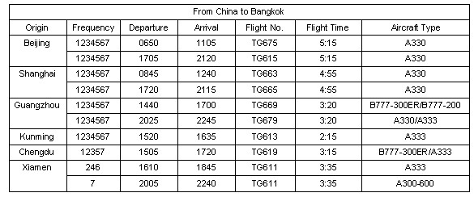
1.2, 5.2, 6.2 Identify and access appropriate resources to enable processing of client requirements
Phonetic alphabet
Airline schedules and flight routes
Example of a Thai Airways timetable from their website:
Notes:
Trainer to advise: PC: 1.2, 5.2, 6.2
Phonetic alphabet
To avoid confusion with accents and different types of speech and to eliminate spelling mistakes with names and booking details, the phonetic alphabet is routinely used.
The phonetic alphabet is used for communication between staff involved in the airline industry. It is particularly useful when spelling out a client’s name over the telephone or when you need to receive or advise a reservation number. An airline or CRS booking number commonly referred to as a PNR or a Reloc is a unique code made up of six letters and numbers. To avoid confusion, the phonetic alphabet is used when staff involved in air travel need to share this information. This will be discussed in more detail in future topics and these terms also appear in the Glossary.
Airline schedules and flight routes
Access to schedules (timetables), fares and information relating to the flights operated by the various carriers is available electronically to travel agents via their Computer Reservation System (CRS) and airline websites.
Activity
In pairs have learners confirm passenger details with each other using their own names.
This activity may also be completed with learners sitting back to back to encourage listening and speaking techniques as specifically needed when communicating via telephone.

Slide 9

Activity for Element 1 - Confirm client requirements for all purchases
Please refer to the Work Projects for Element 1
Notes:
Ensure learners complete the Work Projects at the end of Element 1. Trainer may decide if these are to be completed in class individually or in groups or alternatively as homework.
A copy of work sheets has been included in the Trainer Guide.
Review the Summary page for Element 1 to confirm with learners what has been completed for this Element.

Slide 10
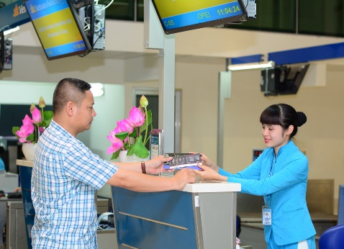
Element 2: Construct mixed class fares
Performance Criteria for this Element are:
2.1 Identify and confirm availability of mixed class combinations
2.2 Match choice of mixed class fare to identified needs of client
2.3 Ensure fare construction complies with operational requirements
2.4 Calculate mixed fare costs
2.5 Construct and check accuracy and completeness of air itineraries
Notes:
Trainer to relate performance criteria to element 2.
Performance criteria is the process by which the students training match the learning element
The element is the skill
To assess competency in the skill, the performance criteria is used to outline activities that can be used to assess competency.
The trainer should relate how the performance criteria is related to the element.
To be able to Construct mixed class fares the students must be able to:
Identify and confirm availability of mixed class combinations
Match choice of mixed class fare to identified needs of client
Ensure fare construction complies with operational requirements
Calculate mixed fare costs
Construct and check accuracy and completeness of air itineraries.

Slide 11
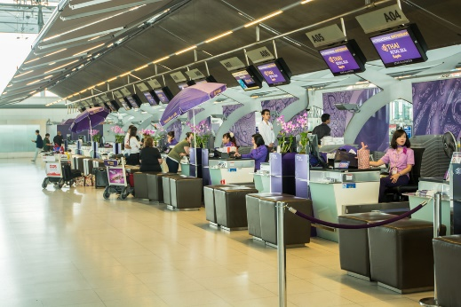
2.1 Identify and confirm availability of mixed class combinations
Identify and confirm availability of mixed class combinations:
Confirming definition and interpretation of mixed class
Identifying carriers who offer this option
Verifying routes to which this option applies
www.qantas.com.au/agents/dyn/qf/fares/routeMapsRead
Verifying advanced purchase timelines/dates
Notes:
Trainer to advise:
PC: 2.1
Availability of mixed class combinations must include:
Confirming definition and interpretation of mixed class
Identifying carriers who offer this option
Verifying routes to which this option applies
Verifying advanced purchase timelines/dates.
Group Activity:
Which carriers offer mixed class tickets?
Interpret route maps on the following Qantas website: www.qantas.com.au/agents/dyn/qf/fares/routeMapsRead

Slide 12
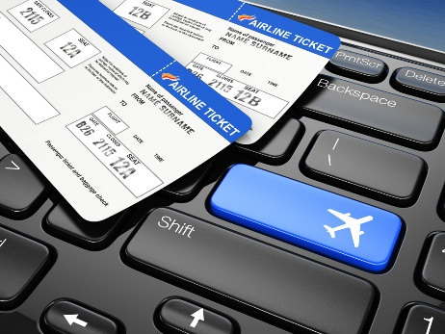
2.2 Match choice of mixed class fare to identified needs of client
Mileage and routing fares
Itinerary types
Codeshare flights
Regular airfare rules
Booking classes
Notes:
Trainer to advise:
PC: 2.2
Discuss each of the points listed using TM notes.
Airfare rules and booking classes is mentioned several times throughout this unit so a thorough discussion at this point would be appropriate.
Trainer to provide examples where possible or access appropriate websites or a CRS for demonstration.
Group Activity
Discuss Itinerary types. Who has experience with flying, booking flights and general travel.

Slide 13

2.3, 3.2, 5.4, 6.5 Ensure fare construction complies with operational requirements
Operational requirements relates to:
Carrier guidelines
Regulatory requirements
Organisational requirements
IATA requirements and procedures, including IATA fare construction rules
Use of correct documentation and/or screens and information fields
Notes:
Trainer to advise:
PC: 2.3, 3.2, 5.4, 6.5
Operational requirements relates to:
Carrier guidelines
Regulatory requirements
Organisational requirements
IATA requirements and procedures, including IATA fare construction rules
Use of correct documentation and/or screens and information fields.
Trainer to provide samples if possible or demonstrate to learners using appropriate websites or CRS.

Slide 14
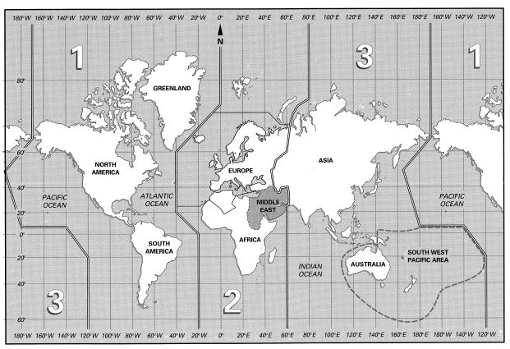
2.3, 3.2, 5.4, 6.5 Ensure fare construction complies with operational requirements
IATA Traffic Conference Areas
Notes:
Trainer to advise:
PC: 2.3, 3.2, 5.4, 6.5
An important component of international airfare construction is to consider the whole journey that the passenger wishes to undertake. This includes the airlines flown and the direction of travel across the globe, particularly across the world’s oceans. For fare construction purposes, IATA has divided the world into three Traffic Conference areas, numbered TC1, TC2 and TC3.
You may also come across the terms "Western Hemisphere” and "Eastern Hemisphere". The world is split into two (uneven) halves:
Western Hemisphere: All of Area 1, that is, north, central and south America
Eastern Hemisphere: All of Areas 2 and 3, that is, Europe, Africa, Asia and Australia.
Refer to TM and take time to explain these regions. Quiz learners to gauge understanding and further explain as needed.
Global Indicators (GI)
Take time to carefully explain GI and the various terms as listed in the TM

Slide 15

2.3, 3.2, 5.4, 6.5 Ensure fare construction complies with operational requirements
Terminology
Terms relating to regular airfare construction
Terms relating to itineraries:
Terms relating to pricing an itinerary
Notes:
Trainer to advise:
PC: 2.3, 3.2, 5.4, 6.5
Review the terminology listed in the TM. Explain those that are not clear.
Allow time for learners to quiz each other on specific codes, providing the opportunity to verbally identify them.

Slide 16
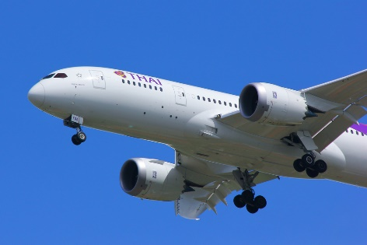
2.4, 5.5, 6.6 Calculate mixed fare costs
Calculate mixed fare costs may include:
Referring to relevant carrier schedules/timetables and tariff information
Referring to specials available and packages that apply
Factoring in applicable discounts, where appropriate
Notes:
Trainer to advise:
PC: 2.4, 5.5, 6.6
Calculate mixed fare costs may include:
Referring to relevant carrier schedules/timetables and tariff information
Referring to specials available and packages that apply
Factoring in applicable discounts, where appropriate.
Group Discussion
Fare types. When airlines may discount. Which airlines don’t discount.

Slide 17

2.5, 3.4, 5.6, 6.7 Construct and check accuracy and completeness of air itineraries
Construct and check accuracy and completeness of air itineraries:
Name and number of passenger/s – including indication of adults and children
Day and date of travel
From and to destinations
Flight number and carrier, including seat allocation
Notes:
Trainer to advise:
PC: 2.5, 3.4, 5.6, 6.7
Air itineraries may include:
Name and number of passenger/s – including indication of adults and children
Day and date of travel
From and to destinations
Flight number and carrier, including seat allocation, where applicable
Departure and arrival times
Fare, taxes, fees and charges, including sub-totals and total
Amount paid and amount due, if applicable
Verification of connections and times, where applicable.
Discuss enterprise policy and procedure variation. Seek input from learners with some experience.
Trainer to provide examples to view and discuss in detail

Slide 18
Activity for Element 2 - Construct mixed class fares
Please refer to the Work Projects for Element 2
Notes:
Ensure learners complete the Work Projects at the end of Element 2. Trainer may decide if these are to be completed in class individually or in groups or alternatively as homework.
A copy of work sheets has been included in the Trainer Guide.
Review the Summary page for Element 2 to confirm with learners what has been completed for this Element.

Slide 19
Element 3: Construct airfares incorporating add-ons
Performance Criteria for this Element are:
3.1 Identify and interpret available and applicable add-on flights
3.2 Ensure fare construction complies with operational requirements
3.3 Calculate through fare costs including add-ons
3.4 Construct and check accuracy and completeness of air itineraries
Notes:
Trainer to relate performance criteria to element 3.
Performance criteria is the process by which the students training match the learning element
The element is the skill
To assess competency in the skill, the performance criteria is used to outline activities that can be used to assess competency.
The trainer should relate how the performance criteria is related to the element.
To be able to Construct airfares incorporating add-ons the students must be able to:
Identify and interpret available and applicable add-on flights
Calculate through fare costs including add-ons.

Slide 20
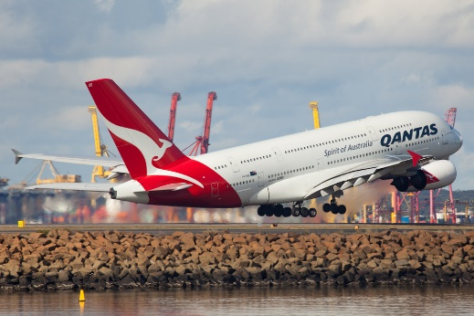
3.1 Identify and interpret available and applicable add-on flights
Available and applicable add-on flights may relate to:
Add-on tables
Specific flights
Availability
Nominated carriers
Specified routes/destinations
Integration with full packages
Compatibility with nominated class
Prohibition on separate sale
Confirming currency of guidelines that apply to add-ons with carriers
Individual terms and conditions of carriers
Notes:
Trainer to advise on each topic as necessary
PC: 3.1
Available and applicable add-on flights may relate to:
Add-on tables
Specific flights
Availability
Nominated carriers
Specified routes/destinations
Integration with full packages
Compatibility with nominated class
Prohibition on separate sale
Confirming currency of guidelines that apply to add-ons with carriers
Individual terms and conditions of carriers.

Slide 21

3.1 Identify and interpret available and applicable add-on flights
Availability
AN25JULSINHKG
1 3K 691 Y4 W4 V4 T4 S4 R4 Q4 SIN 1 HKG 2 0640 1025 3.45
O4 N4 M4 L4 K4 H4
2 SQ 860 F4 P4 A4 Z4 C4 J0 D4 SIN 3 HKG 1 0830 1215 S9 Y9 B9 E9 Q9 N9 V0 T0 M9 H9 W0 L9 K9
Notes:
Trainer to advise: PC: 3.1
Using the example and notes from the TM explain to learners how to break down and interpret this information.
Group discussion
Currency codes, airfares and rules.

Slide 22
3.1 Identify and interpret available and applicable add-on flights
Neutral Units of Construction - NUCs
Rates of Exchange (ROE)
Currency codes
Country | Currency name | Currency code
China | Yuan or Renminbi | CNY
France | Euro | EUR
Hong Kong | Dollar | HKD
Sweden | Kroner | SEK
Malaysia | Malaysian Ringgit | MYR
Morocco | Dirham | MAD
Philippines | Peso | PHP
Singapore | Singapore Dollar | SGD
Thailand | Baht | THB
United States | Dollar | USD
Great Britain | Pound | GBP
Notes:
Trainer to advise: PC: 3.1
Neutral Units of Construction - NUCs
When constructing regular international airfares, a neutral currency is used. It is referenced as NUC - Neutral Unit of Construction (or Neutral Unit of Currency).This neutral currency has been developed by IATA, specifically for use in international airfare construction.
All regular airfares are published in NUC and can be accessed in a CRS through a Fare Display entry. When constructing an airfare for an itinerary, there are a series of checks that must be conducted. Some of these checks result in a higher airfare needing to be charged. This is referred to as the applicable fare. It is only after determining the applicable airfare that the NUC amount is converted into a real currency using an exchange rate called ROE – Rate of Exchange.
Rates of Exchange (ROE)
The Rates of Exchange are determined by IATA and stored in the CRS. The ROEs are updated quarterly on 01JAN, 01APR, 01JUL and 01OCT, or more frequently if there are significant currency changes during that time.
After constructing an airfare, the agent can do a simple calculation in their CRS to convert NUCs into a real currency. The currency is generally the currency for the first city (country) on the itinerary, or the currency of the country in which the enterprise and CRS are located. For example, a fare from Singapore will be displayed in Singapore dollars. In order to convert NUC to a real currency using the ROE, the agent needs to know the code for the currency. The Galileo entry to convert NUCs using the ROE will be introduced later in this unit.
Currency codes
Each currency code also has an internationally recognised three letter code. Generally, the code will appear in a CRS or on an airline website, before the airfare price to indicate which currency is being quoted.
Some countries choose to use US Dollars (USD) for international airfare calculations due to instability and fluctuations in the local currency.
Activity
Learners to access a currency website and familiarise themselves with popular or common world currencies and their coding. Learners to quiz each other to test their knowledge

Slide 23
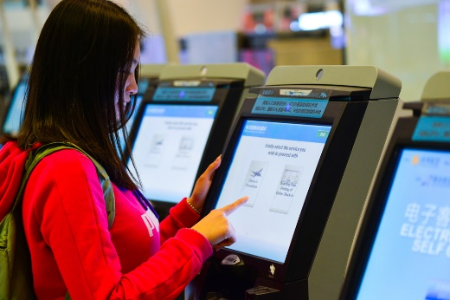
3.3 Calculate through fare costs including add-ons
Calculate through fare costs including add-ons
Accessing airfares in Galileo
Galileo Fare Displays
Notes:
Trainer to advise:
PC: 3.3
Accessing airfares in Galileo
Galileo Fare Displays.
Group Discussion/Activity
After review of TM notes and discussion of topics listed learners to take time to work in pairs and once again interpret the screens in example 1 an 2
Review the Return Airfare example in TM and ensure understanding. Again working in pairs interpret the screen in the example.

Slide 24

3.3 Calculate through fare costs including add-ons
Mileage information
Maximum Permitted Mileage
Excess Mileage Allowance
Excess Mileage Surcharge
Notes:
Trainer to advise:
PC: 3.3
Maximum Permitted Mileage
When reading a Fare Display, the Maximum Permitted Mileage (MPM) is displayed to indicate the maximum number of miles that can be flown between the origin and destination cities. This MPM must be compared to the number of miles being flown on the itinerary. A CRS can calculate the mileage very simply but it is important for the agent to be able to interpret the information provided. In order to do this, the agent must be aware of the following mileage terms and concepts:
MPM – Maximum Permitted Mileage
TPM – Tickets Point Mileage
EMS – Excess Mileage Surcharge
EMA – Excess Mileage Allowance.
Excess Mileage Allowance
There will be itineraries where the TPM is higher than the MPM. In this case, in some circumstances there may be a deduction known as an Excess Mileage Allowance (EMA) which can be applied. IATA has determined which itineraries are entitled to this allowance and will deduct miles from the total TPM if the itinerary is eligible for an EMA.
The EMA example we will consider applies for travel within Area 3 only. When an itinerary only involves travel within TC Area 3 and travel is via Delhi and Mumbai, IATA allows an EMA (if required). This is also the case for an itinerary within TC Area 3 which includes travel via both Karachi and Islamabad.
This is best described using an example. In this Galileo screen, the TPM is calculated for a journey from Vientiane to Bangkok to Delhi to Mumbai.
Excess Mileage Surcharge
In the following example, the itinerary is much longer. This is a more realistic example of an itinerary that might be constructed using a regular airfare. The flown itinerary is Jakarta to Manila to Singapore to Dubai to Paris. Encoded, the itinerary is written as: JKT MNL SIN DXB PAR. The Global Indicator for this itinerary is EH.
Refer to TM for remainder of notes.
Trainer to provide examples for learners to calculate mileage surcharge.

Slide 25
Activity for Element 3 - Construct airfares incorporating add-ons
Please refer to the Work Projects for Element 3
Notes:
Ensure learners complete the Work Projects at the end of Element 3. Trainer may decide if these are to be completed in class individually or in groups or alternatively as homework.
A copy of work sheets has been included in the Trainer Guide.
Review the Summary page for Element 3 to confirm with learners what has been completed for this Element.

Slide 26
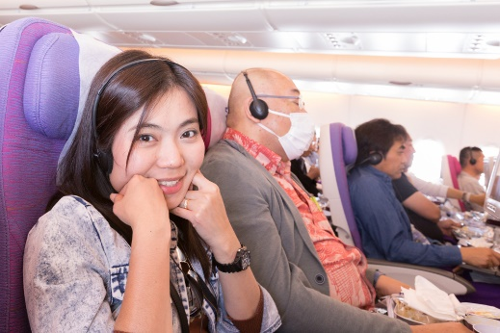
Element 4: Prepare International Pre-paid ticket advices
Performance Criteria for this Element are:
4.1 Determine the needs and preferences of client for pre-paid ticket advice (PTA)
4.2 Select flight and carrier that best meets client needs
4.3 Process PTA in accordance with operational requirements
4.4 Issue or forward PTA
Notes:
Trainer to relate performance criteria to element 4.
Performance criteria is the process by which the students training match the learning element
The element is the skill
To assess competency in the skill, the performance criteria is used to outline activities that can be used to assess competency.
The trainer should relate how the performance criteria is related to the element.
To be able to Prepare International Pre-paid ticket advices the students must be able to:
Determine the needs and preferences of client for pre-paid ticket advice (PTA)
Select flight and carrier that best meets client needs
Process PTA in accordance with operational requirements
Issue or forward PTA.

Slide 27

4.1 Determine the needs and preferences of client for pre-paid ticket advice (PTA)
Determine the needs and preferences of client for pre-paid ticket advice (PTA):
Identify needs
Invoices
Tickets, vouchers and final itinerary
Delivery options
Notes:
Trainer to advise:
PC: 4.1
Identify needs
Invoices
Tickets, vouchers and final itinerary
Delivery options.
Activity
In pairs or small groups create a 3 day, 2 night tour for clients of your choosing and research the following airline structures:
Invoice
Tickets
Vouchers

Slide 28

4.1 Determine the needs and preferences of client for pre-paid ticket advice (PTA)
Determine the needs and preferences of client for pre-paid ticket advice (PTA):
Identify needs
Invoices
Tickets, vouchers and final itinerary
Delivery options
Notes:
Trainer to advise:
PC: 4.1
Identify needs
Invoices
Tickets, vouchers and final itinerary
Delivery options.
Group Activity
Following on from previous slide continue to research the following airline structures:
Final Itinerary
Delivery options
Create an email informing a client for their final itinerary.
Trainer to determine if groups will present their findings.

Slide 29

4.2 Select flight and carrier that best meets client needs
Select flight and carrier that best meets client needs includes:
Confirming availability
Understanding relevant carrier policies and procedures, including limitations and restrictions
Matching timing requirements to flight availability
Seat availability
Notes:
Trainer to advise:
PC: 4.2
Select flight and carrier may include:
Confirming availability
Understanding relevant carrier policies and procedures, including limitations and restrictions
Matching timing requirements to flight availability
Seat availability
Meeting connecting flights
Package limitations, where applicable.
Activity
Trainer note: This activity may follow on from previous or a new scenario may be created.
Select a flight carrier and complete the following information. Once completed, present your findings
Confirming availability
Understanding relevant carrier policies and procedures, including limitations and restrictions
Matching timing requirements to flight availability
Seat availability
Meeting connecting flights
Package limitations, where applicable.

Slide 30

4.3 Process PTA in accordance with operational requirements
Processing PTA in accordance with operational requirements may include:
Following relevant guidelines, policies and procedures
Confirming applicable timeline requirements for booking
Verifying agency details with carrier
Including services covered by PTAs, including excess baggage, unaccompanied children, oxygen use
Notes:
Trainer to advise: PC: 4.3
Process PTA may include:
Following relevant guidelines, policies and procedures
Confirming applicable timeline requirements for booking
Verifying agency details with carrier
Including services covered by PTAs, including excess baggage, unaccompanied children, oxygen use
Obtaining fare quote
Applying service charge
Raising Miscellaneous Charge Order (MCO).
Group Activity
Identify one airline and discuss one of the following items based on that airline- present your findings once you have completed
Following relevant guidelines, policies and procedures
Confirming applicable timeline requirements for booking
Verifying agency details with carrier
Including services covered by PTAs, including excess baggage, unaccompanied children, oxygen use

Slide 31
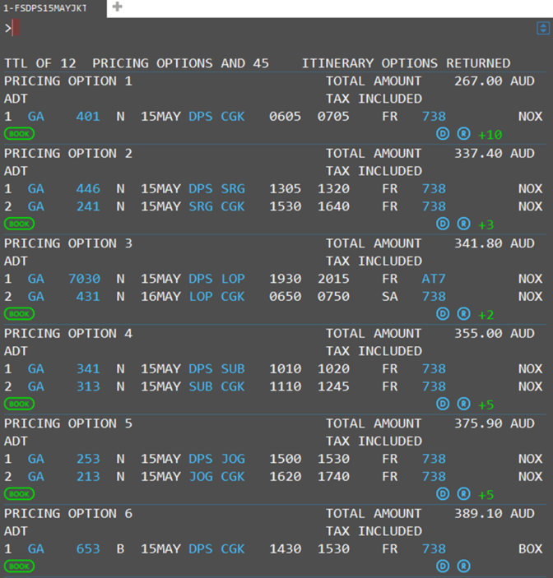
4.3 Process PTA in accordance with operational requirements
Obtaining fare quote
Applying service charge
Raising Miscellaneous Charge Order (MCO)
Notes:
Trainer to advise: PC: 4.3
Process PTA may include: continued
Obtaining fare quote
Applying service charge
Raising Miscellaneous Charge Order (MCO).
Note to trainer: Since 2008 paper tickets were finally phased out and replaced with electronic ticketing, so this process is now much simpler. All ticket transactions are now reported through the agent GDS to the Data Processing Centre and V-MPDs can be issued.
Miscellaneous charge orders (MCO
Miscellaneous charge orders (MCO) have now been replaced with a virtual MPD
A multi-purpose document (MPD) is used by the agent to make payment to airlines for non-air services such as excess baggage, ground transportation and accommodation. The document is now called a Virtual MPD (abbreviated to V-MPD) which is issued by the agent
Group Activity – continues from previous slide
Identify one airline and discuss one of the following items based on that airline- present your findings once you have completed
Obtaining fare quote
Applying service charge
Raising Miscellaneous Charge Order (MCO).

Slide 32

4.4 Issue or forward PTA
Issue or forward PTA
Issuing an PTA
Accredited and non accredited enterprises
Issuing tickets
Notes:
Trainer to advise:
PC: 4.4
Issuing an PTA
Accredited and non accredited enterprises
Issuing tickets.
Group Discussion
Identify and Discuss Accredited and non accredited enterprises.

Slide 33
Activity for Element 4 - Prepare International Pre-paid ticket advices
Please refer to the Work Projects for Element 4
Notes:
Ensure learners complete the Work Projects at the end of Element 4. Trainer may decide if these are to be completed in class individually or in groups or alternatively as homework.
A copy of work sheets has been included in the Trainer Guide.
Review the Summary page for Element 4 to confirm with learners what has been completed for this Element.

Slide 34

Element 5: Construct round-the-world and round trip itineraries
Performance Criteria for this Element are:
5.1 Identify and confirm needs and preferences of client
5.2 Identify and access appropriate resources to enable processing of client requirements
5.3 Identify and confirm availability of flights to meet client requirements
5.4 Ensure fare construction complies with operational requirements
5.5 Calculate fare costs
5.6 Construct and check accuracy and completeness of air itineraries
Notes:
Trainer to relate performance criteria to element 5.
Performance criteria is the process by which the students training match the learning element
The element is the skill
To assess competency in the skill, the performance criteria is used to outline activities that can be used to assess competency.
The trainer should relate how the performance criteria is related to the element.
To be able to Construct round-the-world and round trip itineraries the students must be able to:
Identify and confirm needs and preferences of client.

Slide 35
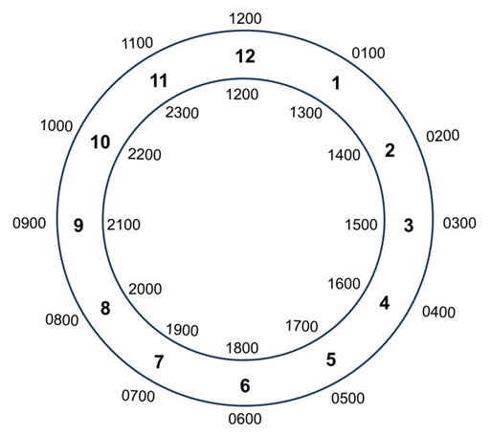
5.3, 6.4 Identify and confirm availability of flights to meet client requirements
Airline time principles
The 24 hour clock
Notes:
Trainer to note that many PCs from this element are repeated and are covered in previous slides. Trainer to decide relevance of repeating or revisiting these slides based on training needs.
Trainer to advise: PC: 5.3,6.4
Discuss
Take time to explain each of the listed points.
The following website has an interactive map that may be useful for activities.
http://www.timeanddate.com/time/map/
Activity – 24 hour clock
Conduct a quick quiz for converting clock times.
17.30, 0030, 19.50, 2100, 1545, 2025, 1615, 1400, 2340, 1310, 0500, 0915 Now convert 9.30pm, 825am, midday, midnight, 11pm, 5.55am, 7.20pm
If conducted in quiz fashion with a time limit and quick pace this can be a funny exercise. Aim to go around the class 2-3 times depending on group size.
Activity - 24 hour time zones.
Calculate the following city times
7pm in Jakarta what time is it in New York
2pm in Phnom Penh what time is it in Auckland and Manila
11pm in Vientiane what time is it in London
Midnight in KL what time is it in Bombay
5am in Bandar Seri Begawan what time is it in Toronto and Bangkok

Slide 36
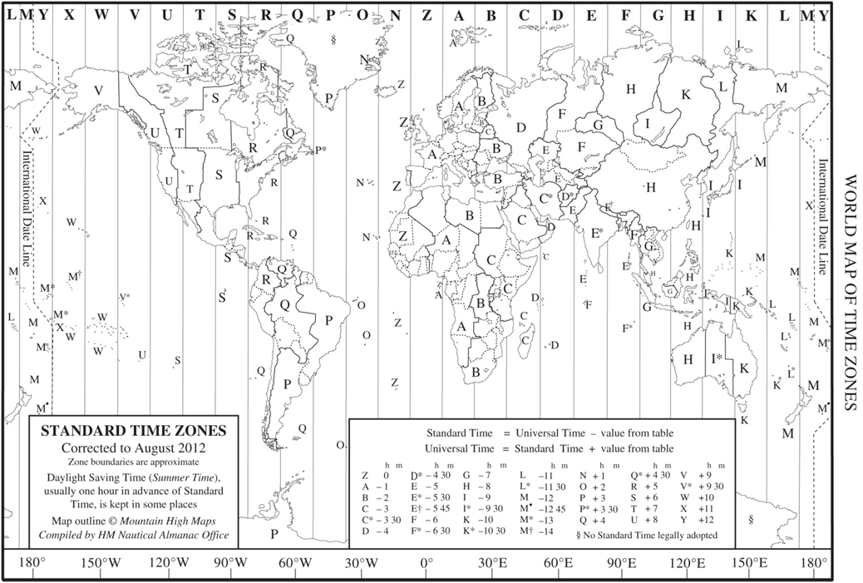
5.3, 6.4 Identify and confirm availability of flights to meet client requirements
Time Zones http://www.timeanddate.com/time/time-zones.html
Notes:
Time Zones
The Greenwich Meridian, also known as the prime meridian or International Meridian, is the "starting point" for dividing the Earth's surface into time zones. Each time zone is 15 degrees of longitude wide (with local variations) and the local time is one hour earlier than the zone immediately to the east on the map
The number of standard time zones is debatable and discussed among various sources, particularly with regards to the International Date Line.
Reference: http://www.timeanddate.com/time/time-zones.html. This website has a great deal of useful information and is worth exploring.
A basic explanation is that time zones to the west of UTC are behind UTC and times to the east of UTC are ahead of UTC.
E.g. If the time is 1200 noon in London (as Greenwich coincides with the position of London) it will be morning in the USA.
If the time is noon in London, then it will be the afternoon in parts of Asia.
Access the website and continue discussion on time zones.

Slide 37

5.3, 6.4 Identify and confirm availability of flights to meet client requirements
Departure and arrival times
Minimum connecting time between flights
Airports
Notes:
Trainer to advise: PC: 5.3,6.4
Departure and arrival times
Airline timetables will always be stated in local time for arrival and departure; therefore you will need to consult the CRS to confirm the duration of the flight, or the timetable if it details that information. Never estimate the flight duration from the arrival and departure times as you must take into account the times zones the flight may cross. Times must be converted back to UTC/GMT time before flight durations can be calculated.
Minimum connecting time between flights
Minimum connecting time is the minimum time you must allow for a passenger to complete a transfer from one flight to another. This time will vary depending if the client needs to change carriers, terminals or even airports. You will learn in your CRS training how to confirm the minimum time allowance and what requirements there are. It is your responsibility to ensure that your passenger has sufficient connecting time between their flights.
Airports
Airlines operate flights from various airports and terminals. Some airports have all their terminals (domestic and international) in the same location. In some cities there may be various airline specific terminals within an airport precinct. For example in Malaysia there are two airports utilising three terminals.

Slide 38
5.3, 6.4 Identify and confirm availability of flights to meet client requirements
Check-in facilities
Counter check-in
Online check-in
Seat requests
Special Care Passengers
Infants/babies
Unaccompanied minors
Elderly or incapacitated passengers
Day and month abbreviations
Notes:
PC: 5.3,6.4
Discuss the following points referring to TM notes. Share relevant experience.
Check-in facilities
Counter check-in
Online check-in
Seat requests
Special Care Passengers
Infants/babies
Unaccompanied minors
Elderly or incapacitated passengers
Ensure all learners are familiar with common universal abbreviations and frequently used industry abbreviations

Slide 39
Activity for Element 5 - Construct round-the-world and round trip itineraries
Please refer to the Work Projects for Element 5
Notes:
Ensure learners complete the Work Projects at the end of Element 5. Trainer may decide if these are to be completed in class individually or in groups or alternatively as homework.
A copy of work sheets has been included in the Trainer Guide.
Review the Summary page for Element 5 to confirm with learners what has been completed for this Element.

Slide 40

Element 6: Identify options that enable open jaw journeys
Performance Criteria for this Element are:
6.1 Identify and confirm needs and preferences of client
6.2 Identify and access appropriate resources to enable processing of client requirements
6.3 Identify options that enable open jaw journeys
6.4 Identify and confirm availability of flights to meet client requirements
6.5 Ensure fare construction complies with operational requirements
6.6 Calculate fare costs
6.7 Construct and check accuracy and completeness of air itineraries
Notes:
Trainer to relate performance criteria to element 6.
Performance criteria is the process by which the students training match the learning element
The element is the skill
To assess competency in the skill, the performance criteria is used to outline activities that can be used to assess competency.
The trainer should relate how the performance criteria is related to the element.
To be able to Identify options that enable open jaw journeys the students must be able to:
Identify options that enable open jaw journeys.

Slide 41
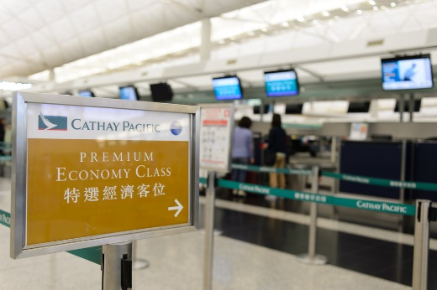
6.3 Identify options that enable open jaw journeys
Identify options that enable open jaw journeys may include:
Considering double open jaw trips
Reading package limitations
Verifying acceptable destinations, en-route destinations and countries
Identifying minimum stay provisions, where applicable
Identifying relative distances involved, where applicable
Catering for circle trips, where necessary
Notes:
Trainer to advise:
PC: 6.3
Identify options that enable open jaw journeys may include:
Considering double open jaw trips
Reading package limitations
Verifying acceptable destinations, en route destinations and countries, including limitations on intra-country and inter-country applications
Conformity with airline and airfare rules, including understanding of the limitations imposed by these
Identifying minimum stay provisions, where applicable
Identifying relative distances involved, where applicable
Catering for circle trips, where necessary.

Slide 42
6.3 Identify options that enable open jaw journeys
Types of open jaw journeys
Notes:
Trainer to advise:
PC: 6.3
Discuss examples of open jaw journeys as needed

Slide 43
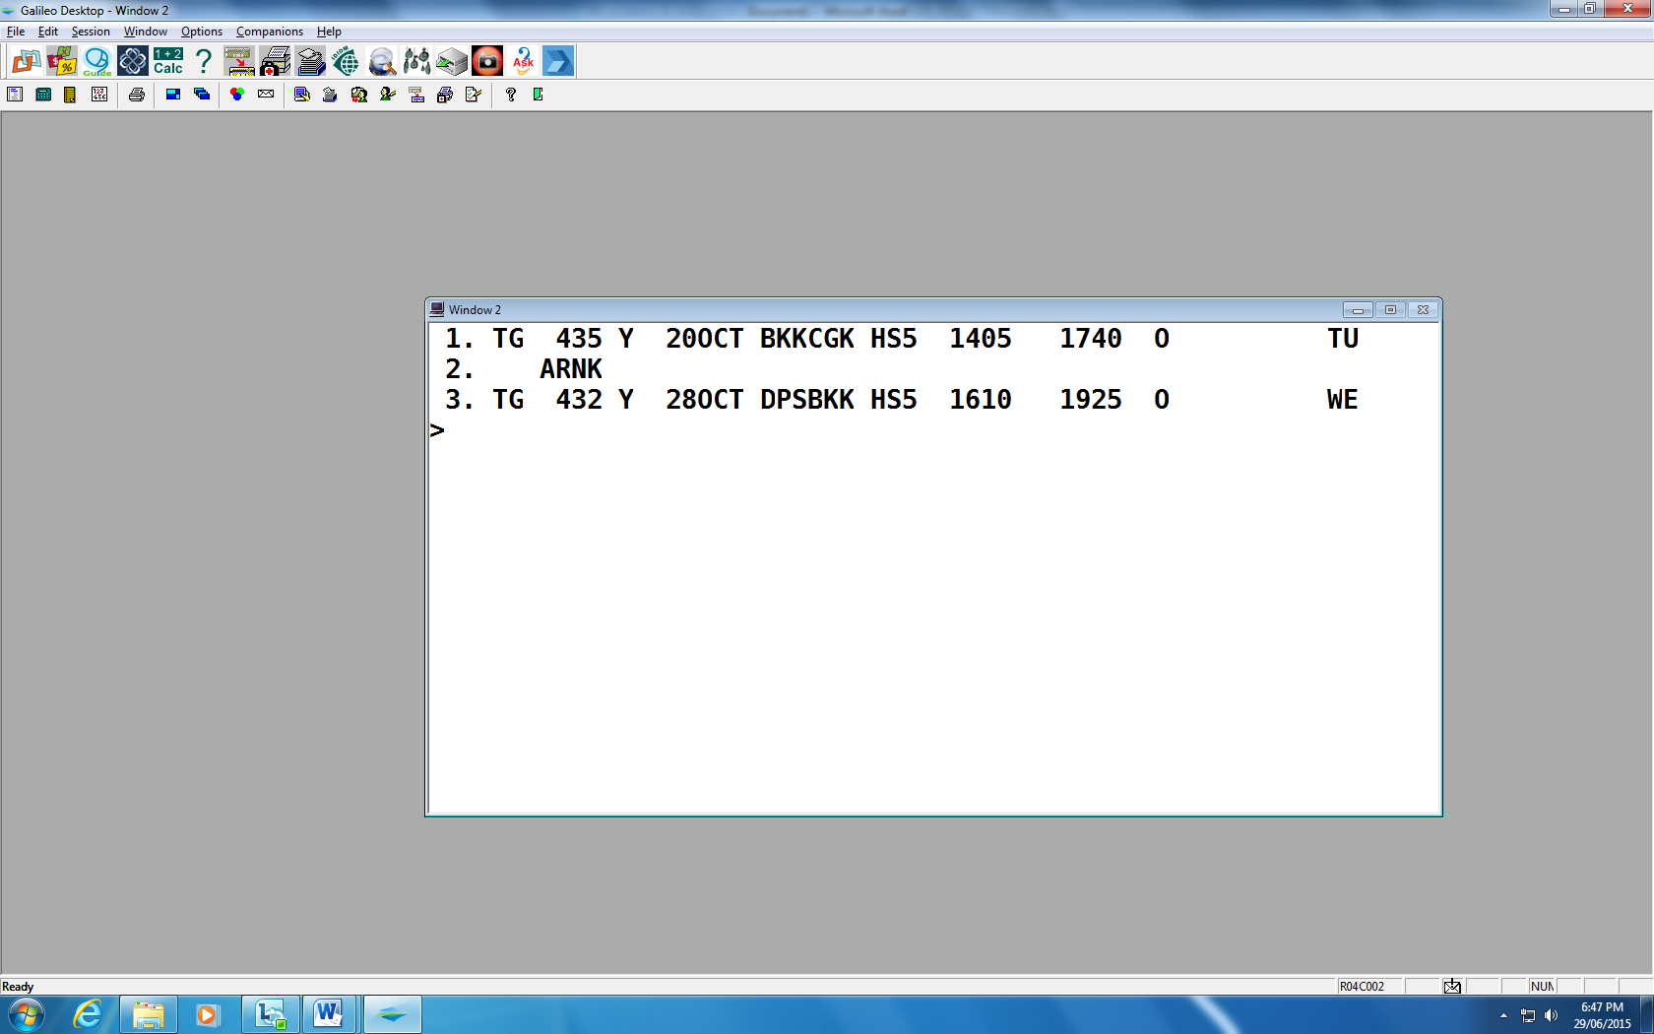
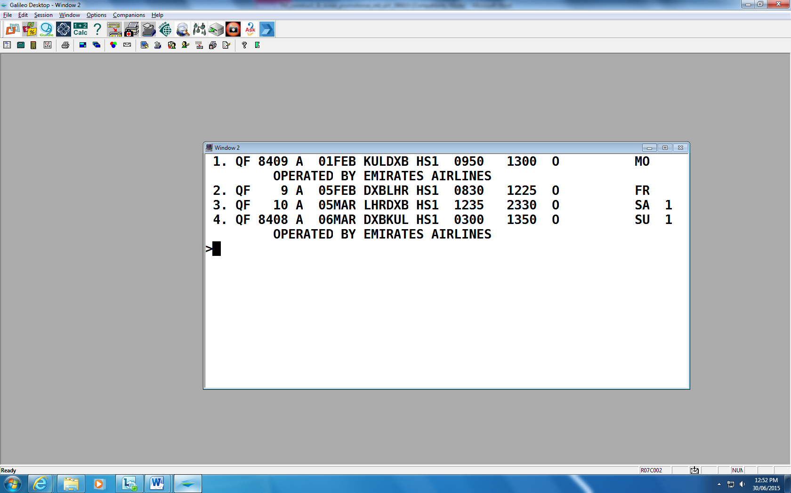
6.3 Identify options that enable open jaw journeys
Open Jaw itinerary and Journeys
Codeshare flights
Notes:
Trainer to advise:
PC: 6.3
Open Jaw itinerary and Journeys
The flights in this itinerary are operated by Thai Airways, flying from Bangkok to Jakarta and returning from Denpasar to Bangkok. The ‘ARNK’ between flights indicates that this sector has not been booked by the agent and means ‘Arrival Unknown’ (or own arrangements). The ‘HS5’ indicates that five seats are being held.
This return journey includes two components.
The outbound component is a non-stop flight from Bangkok to Jakarta.
The inbound component is a non-stop flight from Denpasar to Bangkok.
Jakarta to Denpasar is a surface sector.
Codeshare flights
This itinerary contains codeshare flights which have Qantas flight numbers but are operated by Emirates (Segments 1 and 4). You will note that the Qantas flight numbers contain four digits. This is a way of identifying codeshare services although this is also clearly advised on this booked itinerary.

Slide 44
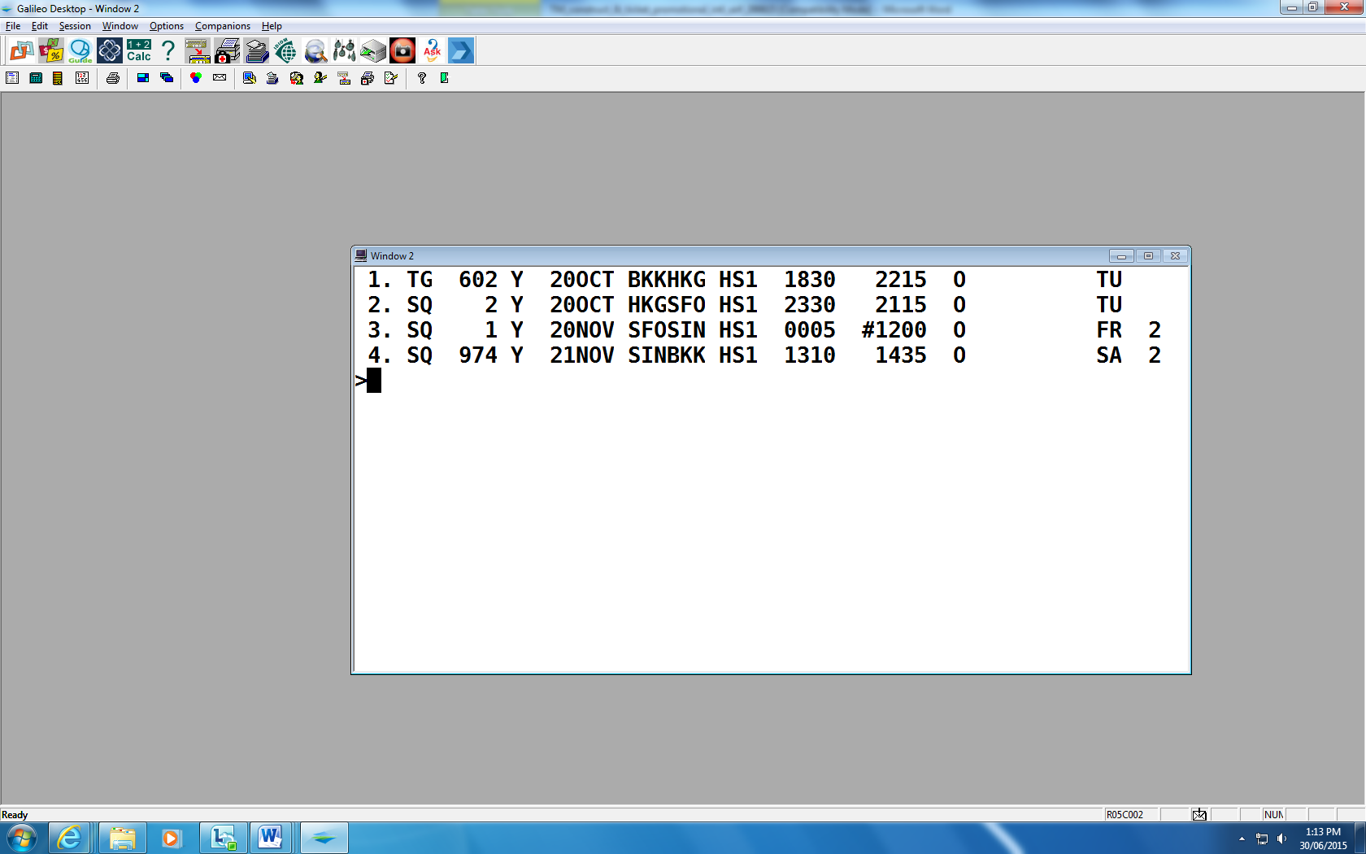
6.3 Identify options that enable open jaw journeys
Online and interline transfers
Notes:
Trainer to advise:
PC: 6.3
Online and interline transfers
The itinerary below is a return journey from Bangkok to San Francisco, flying with Thai Airways and Singapore Airlines.
On the outbound component, the passenger will transit through Hong Kong.
On the inbound component, the passenger will transit through Singapore. Note that flight SQ1 arrives into Singapore at #1200, meaning 12.00pm the next day – 21 November.
The passenger will arrive into Hong Kong on Thai Airways and depart on Singapore Airlines. This is called an interline transfer.
The passenger will return from San Francisco to Singapore and change aircraft, continuing to fly with Singapore Airlines. This is called an online transfer.

Slide 45
6.3 Identify options that enable open jaw journeys
Booking classes
The screen above shows that on Qantas flight QF94, there are four classes of travel and the number of seats available for each
FRI 26JUL LOS ANGELES /MELBOURNE *QANTAS 1 LAX MEL 26/2330*0820 QF 94 F9 A9 J9 C9 D4 I3 W9 R6 T0 Y8 B7 H8 K3 M0 L0 VC SC NC QC OC
Notes:
Trainer to advise: Explain how to interpret the screen information utilising TM notes as well.
PC: 6.3
When an availability screen is displayed in the CRS, the information is displayed in order beginning with first class, then business class, premium economy and economy class. All booking classes on flights can be seen in each availability screen, assuming the operating aircraft offers all classes of service. For example, if there is no F shown on a line in the display, there will not be a first class service offered on that flight.
When reading an availability screen, remember that the airline will only show a maximum of nine seats for each booking class. The airline controls this information and can change their allocation at any time to control the number of seats available at each price level.
The following screen shows the seats available on a Qantas flight from Los Angeles to Melbourne. This screen is called an Availability screen and the entries will be included later on how to display this information.

Slide 46
Activity for Element 6 - Identify options that enable open jaw journeys
Please refer to the Work Projects for Element 6
Notes:
Ensure learners complete the Work Projects at the end of Element 6. Trainer may decide if these are to be completed in class individually or in groups or alternatively as homework.
A copy of work sheets has been included in the Trainer Guide.
Review the Summary page for Element 6 to confirm with learners what has been completed for this Element.

Slide 47

Element 7: Apply the pricing unit concept to fares
Performance Criteria for this Element are:
7.1 Divide fare journey into individual pricing units
7.2 Calculate lowest combination of fares for given pricing units
Notes:
Trainer to relate performance criteria to element 7.
Performance criteria is the process by which the students training match the learning element
The element is the skill
To assess competency in the skill, the performance criteria is used to outline activities that can be used to assess competency.
The trainer should relate how the performance criteria is related to the element.
To be able to Apply the pricing unit concept to fares the students must be able to:
Divide fare journey into individual pricing units
Calculate lowest combination of fares for given pricing units.

Slide 48
7.1 Divide fare journey into individual pricing units
Divide fare journey into individual pricing units
Single fare
Return fare
Notes:
Trainer to advise:
PC: 7.1
Fare journey must include:
Single fare
Return fare.
Discuss
One way journeys
Return Journeys.

Slide 49
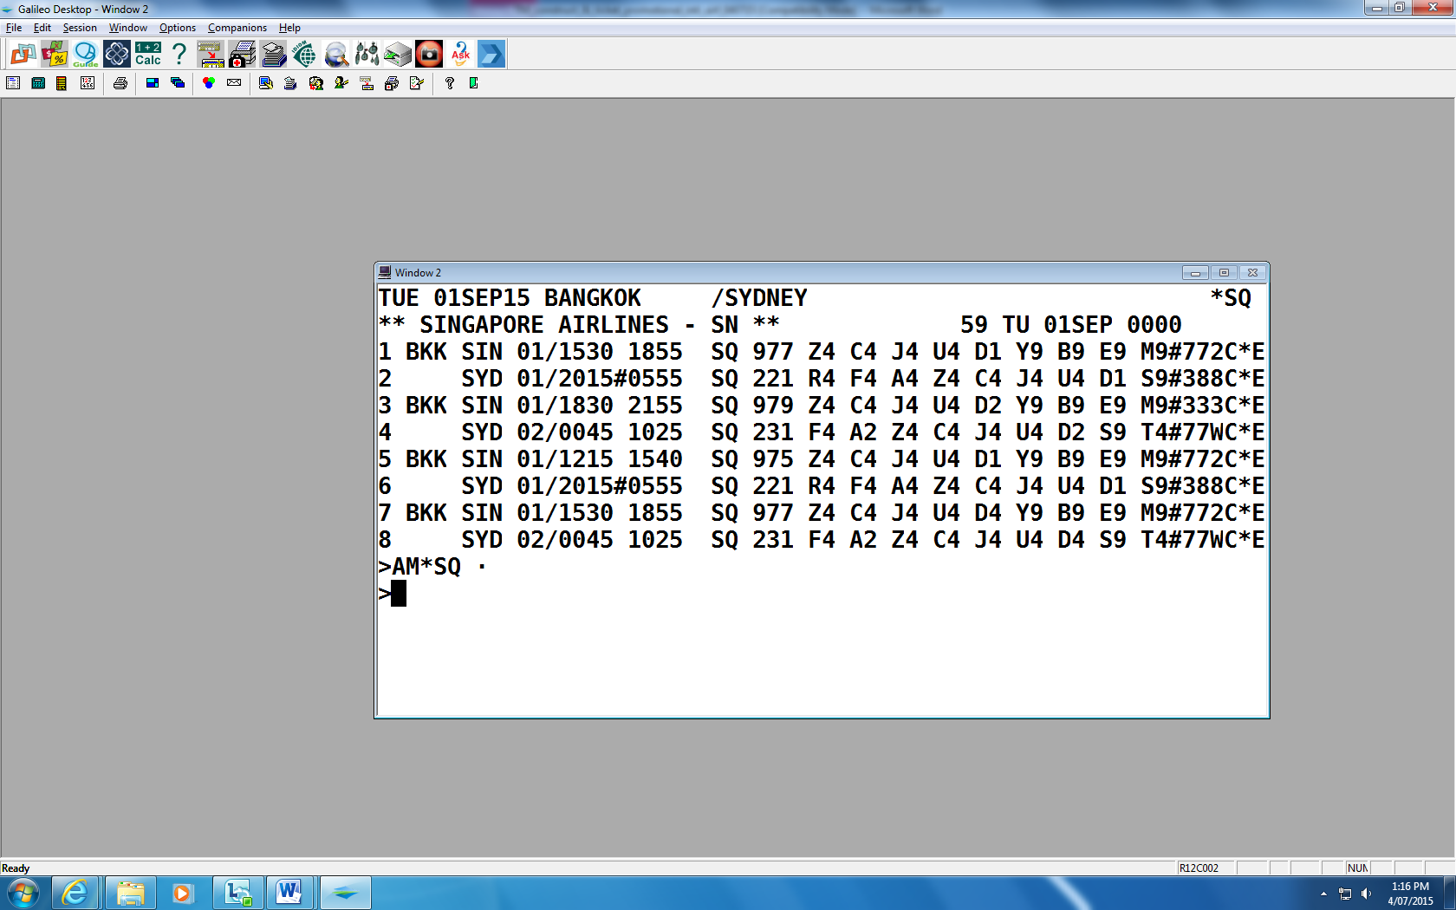
7.1 Divide fare journey into individual pricing units
Divide fare journey into individual pricing units
One way journey
Notes:
Trainer to advise:
PC: 7.1
This screen shows that there are multiple options to travel from Bangkok to Sydney via Singapore, flying Singapore Airlines.

Slide 50
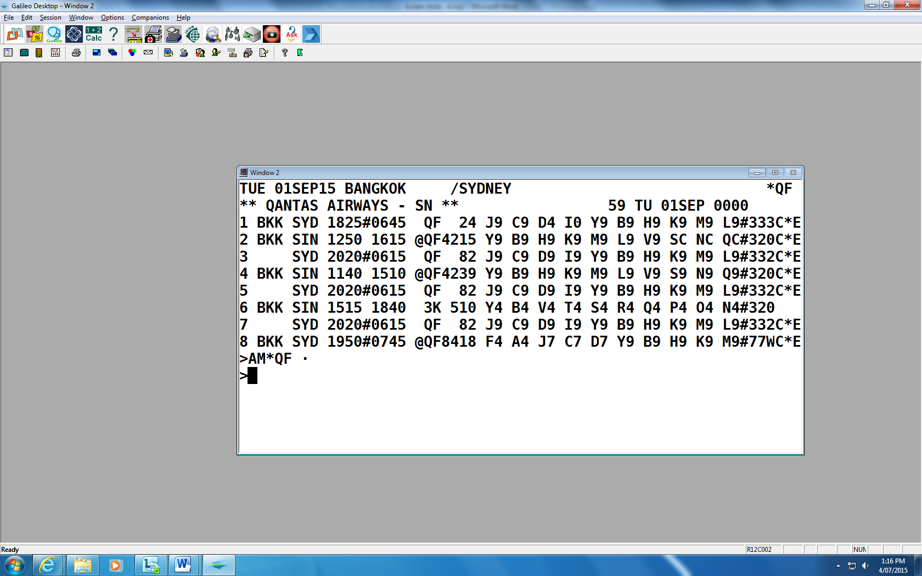
7.1 Divide fare journey into individual pricing units
Availability - One way journey
Notes:
Trainer to advise: PC: 7.1
Availability - One way journeys
Using the Availability entry example above, you could continue to book flights and start creating an itinerary. In order to do this, you would need to know which booking class you will need to use. This information is obtained from a fare display which we will consider in a moment.
Imagining that the above flight itinerary was booked from Bangkok to Sydney only (either with Qantas or Singapore Airlines), this would create a one way journey.
The journey from Bangkok to Sydney on Qantas would be a single sector one way journey.
The journey from Bangkok to Sydney, via Singapore, flying Singapore would be a one way journey with two sectors. Singapore would be considered an intermediate point.
If the passenger is only in Singapore for a short time waiting for their next flight, this intermediate point is referred to as a transit.
If the passenger wishes to stay in Singapore for more than 24 hours, Singapore is considered an intermediate stopover flight. This would require the journey to be booked in two segments, using two availability screens. For example:
Entry: A01SEPBKKSIN*SQ
Entry: A03SEPSINSYD*SQ (Two night stopover in Singapore)

Slide 51
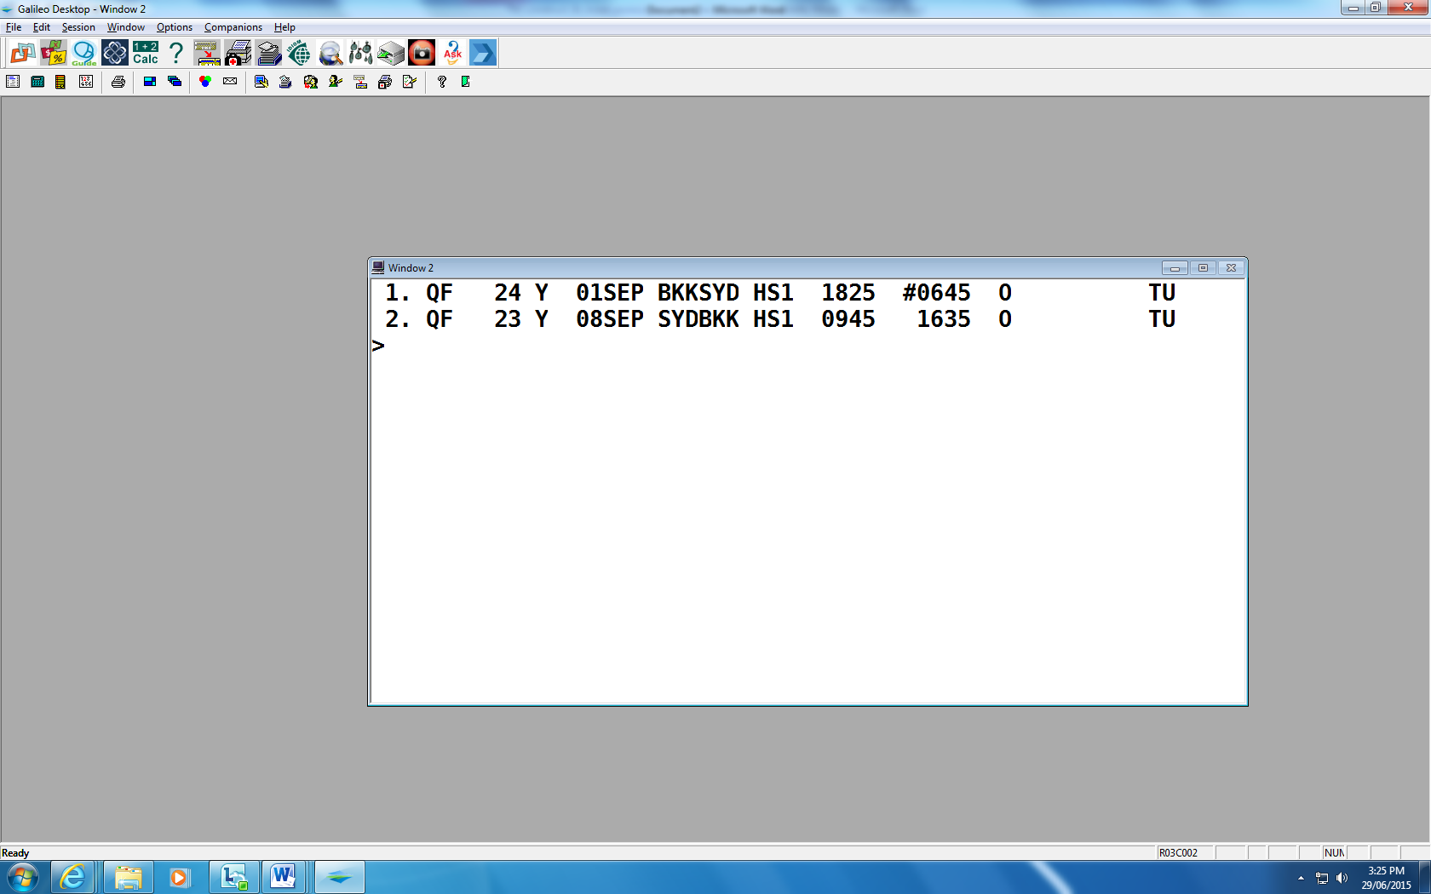
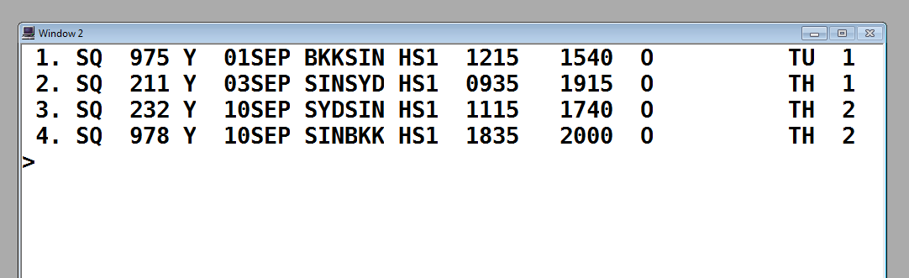
7.1 Divide fare journey into individual pricing units
Availability – Return journeys
Qantas itinerary:
Singapore Airlines itinerary:
Notes:
Trainer to advise:
PC: 7.1
Continuing with the examples above, imagine that the passenger wishes to return from Sydney one week later.
The Qantas entry would be:
Entry: A08SEPSYDBKK*QF
The Singapore Airlines entry would be:
Entry: A10SEPSYDBKK*SQ
(Assuming no stopover is required in Singapore):
Although we have not yet considered which booking classes or flights to book, and the entries required for this part of the process, let’s look at the itineraries that could be created for these booking examples:

Slide 52

7.1 Divide fare journey into individual pricing units
Terminology
Return journeys
Origin
Destination.
Direct, non-stop flight
Online transfer
Outbound component
Stopover
Inbound component
Online transfer
Transit
Notes:
Trainer to advise and quiz learners on terminology used in this section.
PC: 7.1
Terminology
Both itinerary examples above are return journeys. Bangkok is the origin and Sydney is the destination.
The Qantas itinerary has a direct, non-stop flight in each direction.
The Singapore Airlines itinerary has an online transfer through Singapore on the outbound component and Singapore is a stopover. On the inbound component, there is also an online transfer through Singapore, and Singapore is a transit point.

Slide 53

7.2 Calculate lowest combination of fares for given pricing units
Calculate lowest combination of fares for given pricing units
Create an itinerary for one way airfare
Check availability
Notes:
Trainer to advise:
PC: 7.2
Create an itinerary for one way airfare
Check availability.
Activity
Create an itinerary for one way airfare providing the lowest price point.

Slide 54
Activity for Element 7 - Apply the pricing unit concept to fares
Please refer to the Work Projects for Element 7
Notes:
Ensure learners complete the Work Projects at the end of Element 7. Trainer may decide if these are to be completed in class individually or in groups or alternatively as homework.
A copy of work sheets has been included in the Trainer Guide.
Review the Summary page for Element 7 to confirm with learners what has been completed for this Element.

Slide 55

Element 8: Maintain Client File
Performance Criteria for this Element are:
8.1 Record and update needs and preferences of client
8.2 Record itineraries and airfares quoted
8.3 Generate and issue documents to clients
8.4 Record and process changes to bookings
8.5 Record, up-date and receipt payments made by client
Notes:
Trainer to relate performance criteria to element 8.
Performance criteria is the process by which the students training match the learning element
The element is the skill
To assess competency in the skill, the performance criteria is used to outline activities that can be used to assess competency.
The trainer should relate how the performance criteria is related to the element.
To be able to Maintain Client File the students must be able to:
Record and update needs and preferences of client
Record itineraries and airfares quoted
Generate and issue documents to clients
Record and process changes to bookings
Record, up-date and receipt payments made by client.

Slide 56

8.1 Record and update needs and preferences of client
Electronic client record systems
Manual client record systems
Client details
Products and services
Notes:
Trainer to advise: PC: 8.1
Refer to TM notes for these topics.
Electronic client record systems
Manual client record systems
Most travel agents use one of the following methods to record the detail of the products and services booked, their status and other relevant client detail.
1. A totally manual system
2. A totally electronic system
3. A combination of both – most common
Products and services
To ensure accuracy when preparing to issue documentation the following should be checked prior to commencing voucher production.
All passenger names match their photo ID/passport
All passenger names are correct across all items, products or services
All items, products or services have a confirmed status
There is date/city continuity for all items, product or services booked
There are no unexplained gaps in the itinerary
The booking is fully paid
Refer to TM for further notes

Slide 57
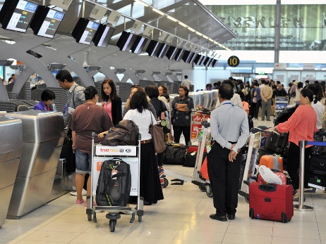
8.2 Record itineraries and airfares quoted
Itineraries and airfares
Itinerary types
Confirming airfare conditions
Notes:
Trainer to advise:
PC: 8.2
Itineraries and airfares quoted may include:
All types of fares and trips offered by the host enterprise
Through fares incorporating add-ons
Mixed class fares
Round, circle and open jaw trips
Fares incorporating intermediate points
Fares incorporating sector journeys and side-trips
Fares incorporating airport and other taxes.
Discuss airfare conditions and penalties and clearly identifying these with the client.
Group Activity
Create an itinerary one of the following itineraries and include a quote for the client:
Round or circle or open jaw trips.

Slide 58
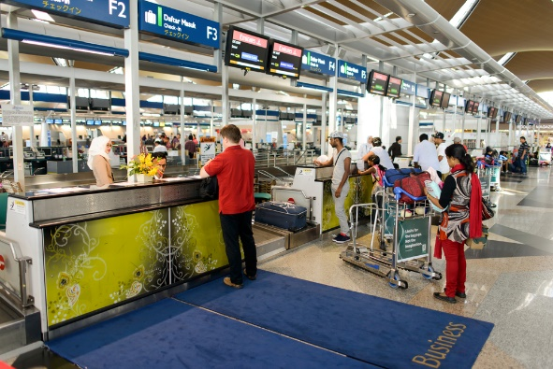
8.3 Generate and issue documents to clients
Documents may also include:
Invoices
Credit notes
Receipts
Confirmation letters
Itineraries
Information packs
Notes:
Trainer to advise:
PC: 8.3
Documents may include:
Invoices
Credit notes
Receipts
Confirmation letters
Itineraries
Information packs.
Ensure learners are familiar with each type of document. Have samples available if possible.

Slide 59

8.3 Generate and issue documents to clients
Letters of confirmation
Verify ticketing details
Verify itinerary
Confirming itinerary details
Issuing an e-ticket using a CRS/GDS
Preparing an invoice
Notes:
Trainer to advise:
PC: 8.3
Using TM notes identify the importance of detailing information in writing and verifying key details for tickets and itinerary regarding names, dates times and so on.
Complete the activity in the TM
Review sample tickets identifying key sections to explain and confirm with client.
Have a sample invoice available for review and discussion as needed.
Activity
Based on the itinerary created in the previous activity at 8.2 , have learners create one of the following documents:
Invoice
Credit note
Receipt
Confirmation letter
Information pack.
Share completed work with the group.

Slide 60
8.4 Record and process changes to bookings
Record and process changes to bookings
Changed arrangements
Cancellations, including the processing of refunds and issuing of credit notes
Verifying alterations with carriers
Notes:
Trainer to advise:
PC: 8.4
Changes to bookings may include:
Changed arrangements
Cancellations, including the processing of refunds and issuing of credit notes
Verifying alterations with carriers
Confirming alterations with clients and issuing appropriate confirmations and amended documentation.
Activity
Based on the itinerary created in the previous activity: made an amendment to meet the clients need. Share the completed changes with the group.

Slide 61

8.5 Record, up-date and receipt payments made by client
Updating maintaining internal records
Payments
Cash payments
Direct deposits
Cheque payment
EFTPOS transactions
Credit card payment directly to airline
Notes:
Trainer to advise: PC: 8.5
Updating maintaining internal records
It is essential that the enterprise maintains accurate and up to date financial records for each booking. The client record will store all of the client’s personal information and details on their current booking and may be linked to past bookings made by the client. Record keeping software used by a travel enterprise is designed to be both an accounting system and client database. To ensure accuracy, all information on payments received should be recorded immediately.
If the client has paid in full for their travel arrangements, you may now update their client records and order their airline ticket/s. If only part payment is received, do not issue airline tickets until the final payment has been received and receipted.
Discuss each of the payment methods and why one is preferred over the other in an agency.
Payments may include:
Credit card
Cash
Personal, business and traveller’s cheque
Direct debit, such as electronic funds transfer
Invoice/account
Telephone
E-mail, or other electronic transmission.

Slide 62
Activity for Element 8: Maintain Client File
Please refer to the Work Projects for Element 8
Notes:
Ensure learners complete the Work Projects at the end of Element 8. Trainer may decide if these are to be completed in class individually or in groups or alternatively as homework.
A copy of work sheets has been included in the Trainer Guide.
Review the Summary page for Element 8 to confirm with learners what has been completed for this Element.

Slide 63

The End
This unit comprises eight elements:
Confirm client requirements for all purchases
Construct mixed class fares
Construct airfares incorporating add-ons
Prepare international pre-paid ticket advices
Construct round-the-world and round trip itineraries
Construct fares for open jaw journeys
Apply the pricing unit concept to fares
Maintain client file
You have now completed this unit and the trainer will provide details on assessment. Good Luck!
Notes:
Trainer advises learners on what assessment is required and how it is to be conducted.

